Slide 1

Uber & Lyft Rideshare Service Analysis
Group 10 - Swati Mambilavil, Colin Quinn, Vedant Chhibber, Otabek Juraev, and Yashveer Shrimal
Notes:
What do I look for in the project presentation?
o How did you define the problem?
o How did you explain the business problem?
o Which algorithms did you choose, and why?
o How did you achieve variable preprocessing and feature selection?
o How did you pick the parameters of algorithms?
o What happened when you altered algorithm parameters?
o Did the performance indicator of the learning algorithm improve after feature selection? If yes, why? If no, why?
o What performance indicators did you use?
What to submit?
o Submit an MS PowerPoint presentation file describing your project
o Submit your code as a Jupyter notebook file and the dataset you used
o NO NEED to submit a project report in MS Word

Slide 2
Introduction
In the modern world, consumers are provided with a plethora of options to choose from when seeking on-demand, efficient transportation such as Uber, Lyft, and traditional taxis
The emergence of ride-hailing technology companies such as Uber & Lyft have revolutionized the transportation services industry – the presence of these companies has made it more efficient than ever for consumers to find an efficient means of travel to-and-from any location, and for heading to work
Despite their efficiency, these services tend to be quite expensive, which in turn can make these services a less feasible option for travel
For many employees, being forced to incur hefty travel costs when commuting to and from work can have detrimental impacts on their personal finances and livelihood
This analysis aims to provide various models for accurately classifying which trips are provided by “Lyft,” a popular rideshare company who offers the industry’s lowest hourly rate for time of travel
The insights generated by our analysis will serve as a valuable asset for employees to use when determining cost efficient travel options, which in turn will help facilitate operations within the business by the reducing cost and boosting efficiency of travel for employees

Slide 3
Describing Dataset
The data for this analysis has been derived from Kaggle and it contains two datasets, “cab_rides.csv” and “weather.csv” which together outline critical information regarding rideshare services & weather for Uber, Lyft, and Taxi rideshare transactions
The variables contained in the “cab_rides.csv” and “weather.csv” dataset include:
distance - the distance traveled (in miles)
cab_type - the rideshare company responsible for a service
time_stamp - time that service is started
destination - endpoint location for a service
source - starting point location for a service
price - price of the transaction
surge_multiplier - multiplier responsible for calculating pricing amounts for riders and drivers
product_id - the type of rideshare service
name - distinguishes the type of vehicle being used to complete the service
temp - temperature (in Fahrenheit) at start of service
location - location (start point) of service where weather is recorded
clouds - cloudiness index during a service reflecting level of cloudiness
pressure - pressure index during a service reflecting level of atmosphere pressure
rain - rain index for a service reflecting level of rain
humidity - humidity index for a service reflecting level of humidity
wind - wind index for a service reflecting level of wind
Our input variables for the analysis are:
distance
destination
source
surge_multiplier
product_id
name
temp
location
clouds
pressure
rain
humidity
Wind
Our output variables for analysis are:
cab_type
price
Notes:
Where has the data been gathered?
What are the input and output variables?
The input variables for our analysis include distance traveled, company, time stamp, destination for arrival & depart respectively, price, and surge multiplier
The output variable for the analysis was the cab_status, a discrete variable with a value of 1 corresponding to “Lyft” services and 0 for “Uber” and “Taxi”

Slide 4
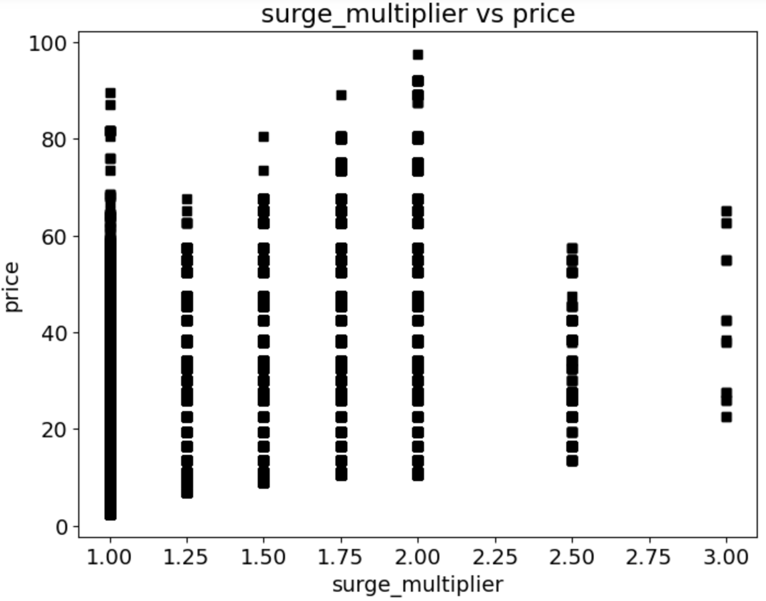
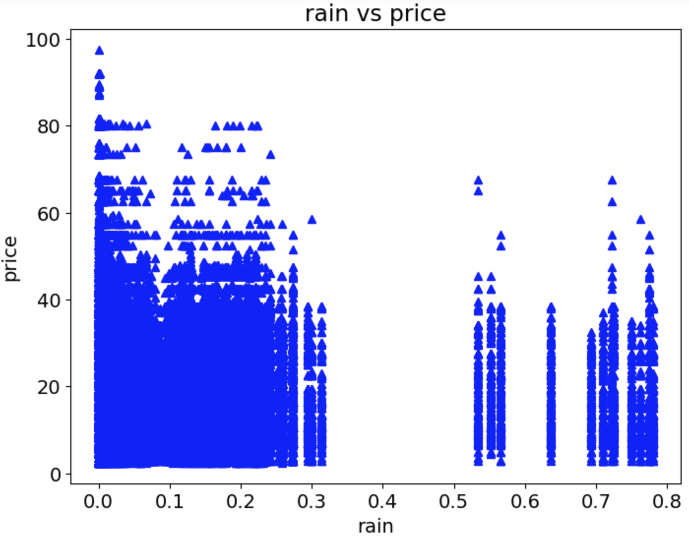
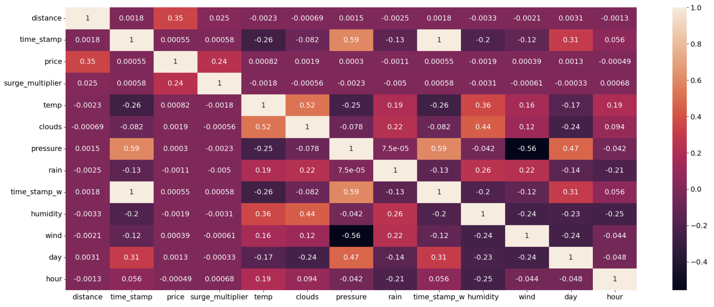
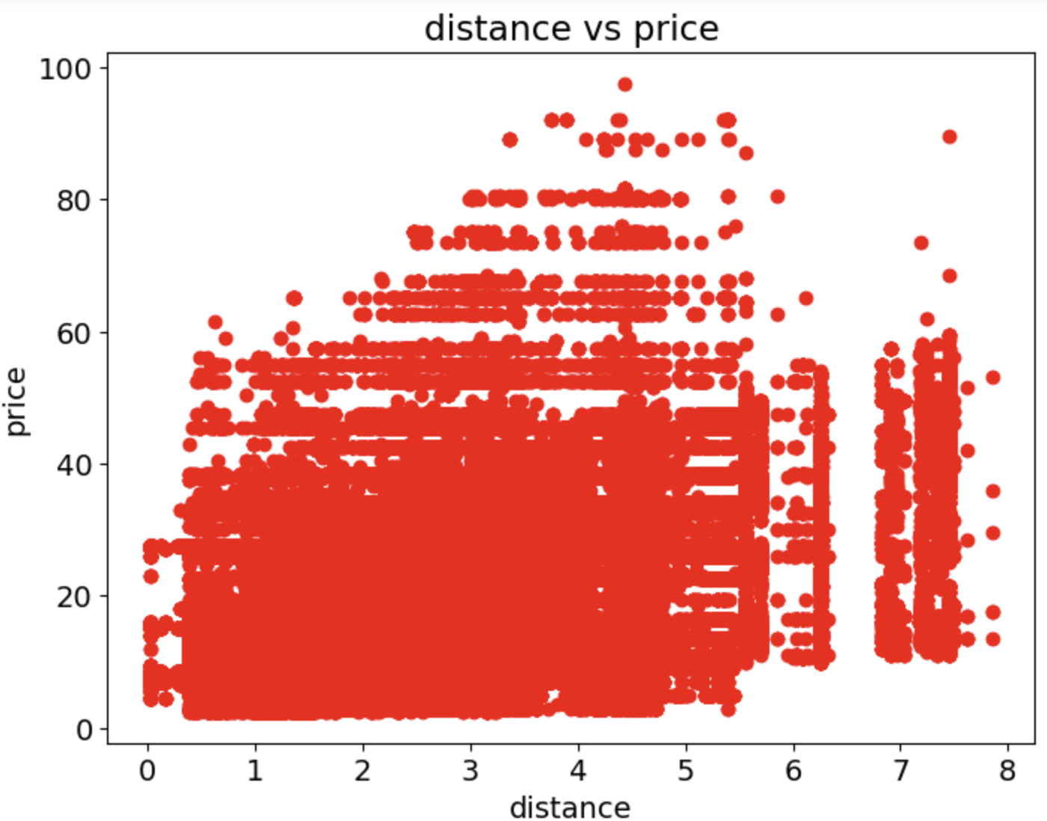
Descriptive Analysis
Fig. 1
The “cab_rides.csv” contains 693, 071 rows and 10 columns
The “weather.csv” contains 6,276 rows and 8 columns
The numerical variables in our analysis did not follow a normal distribution (see Fig. 5 and Fig. 6 on next slide)
Fig. 2
Fig. 4
Fig. 3
Notes:
Number of columns and rows
Percent of missing values by columns
Means, medians, modes, correlations, variance, outliers
Data visualizations such as scatter plots or correlation plots

Slide 5
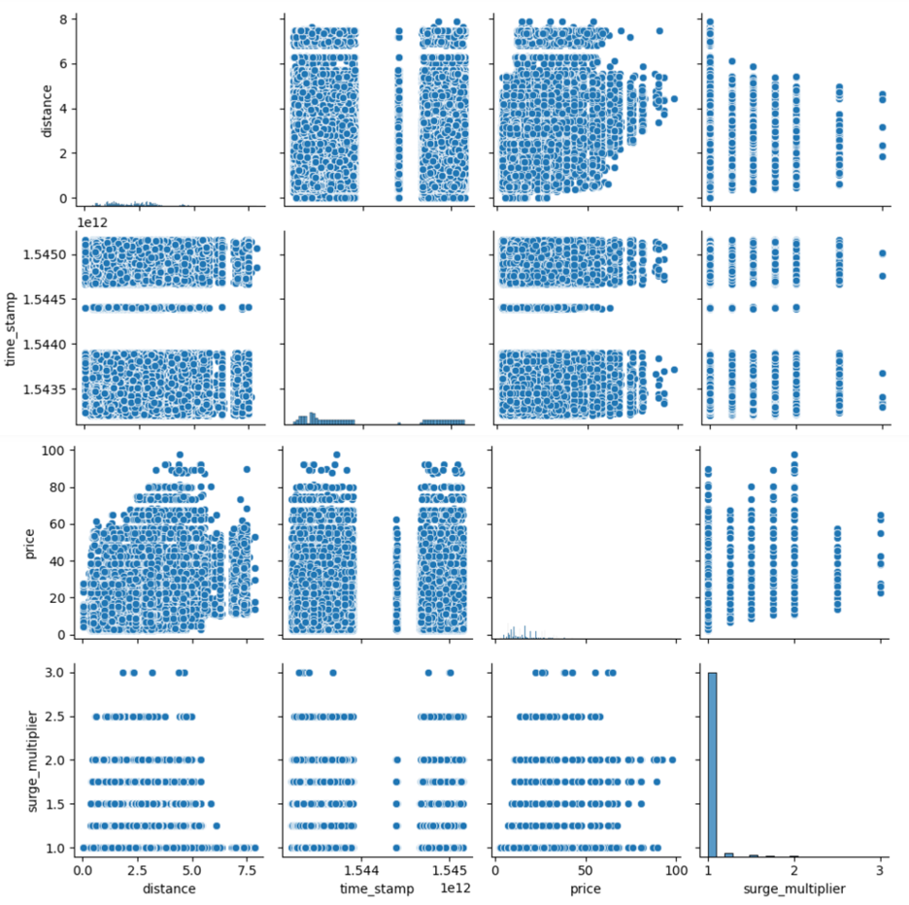
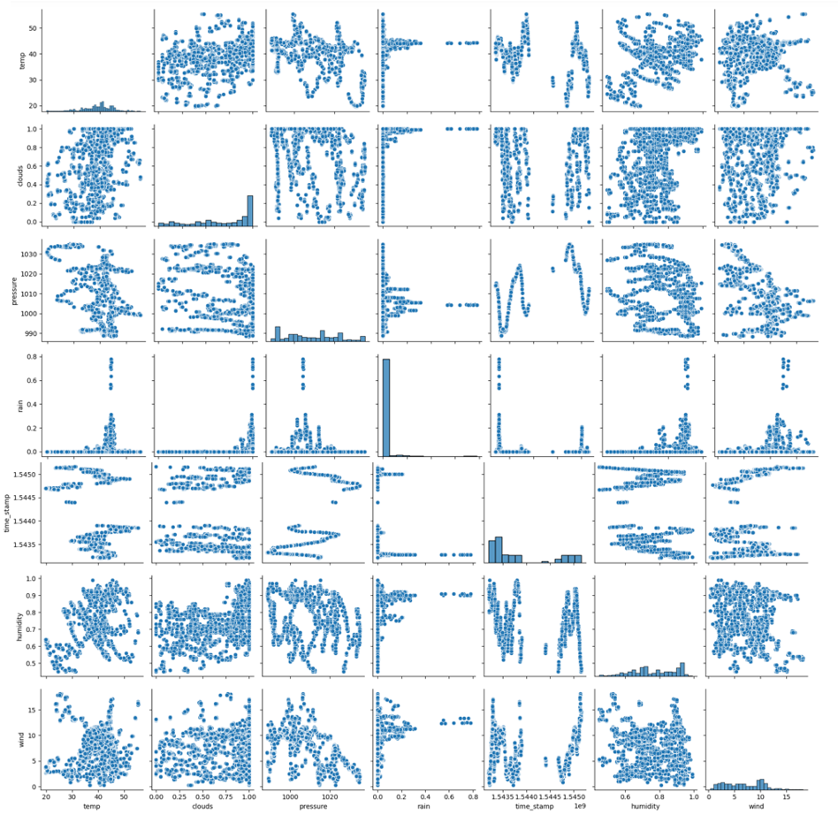
Descriptive Analysis
Fig. 5
Fig. 6
Notes:
Number of columns and rows
Percent of missing values by columns
Means, medians, modes, correlations, variance, outliers
Data visualizations such as scatter plots or correlation plots

Slide 6
Data Pre-Processing
Due to the numerical variables in our dataset not following a normal distribution, we felt it was appropriate to standardize the data.
We also proceeded with encoding our categorical variable so that they were in the proper format to be incorporated into our models.
We ultimately determined that the time_stamp was irrelevant for our analysis, thus we removed the variable entirely
We created a new variable, merge_date, which contained the year, month, day of month, and hour of day for each service recorded in “weather.csv”
This allowed us to incorporate such factors into our analysis when classifying strictly “Lyft” services
We created a new variable, cab_status, which specifies whether a service was completed by “Lyft” with a value of 1 or 0 if it was completed by “Uber”
In our product_id variable we identified several levels, “Black,” “BlackSUV,” and “WAV” which did not correspond to any rideshare services offered by “Uber” or “Lyft”, thus we removed rows which contained these levels as they would be irrelevant for our analysis going forward.
Due to the imbalance observed in our cab_status outcome variable, we proceeded with balancing our data using SMOTE.

Slide 7
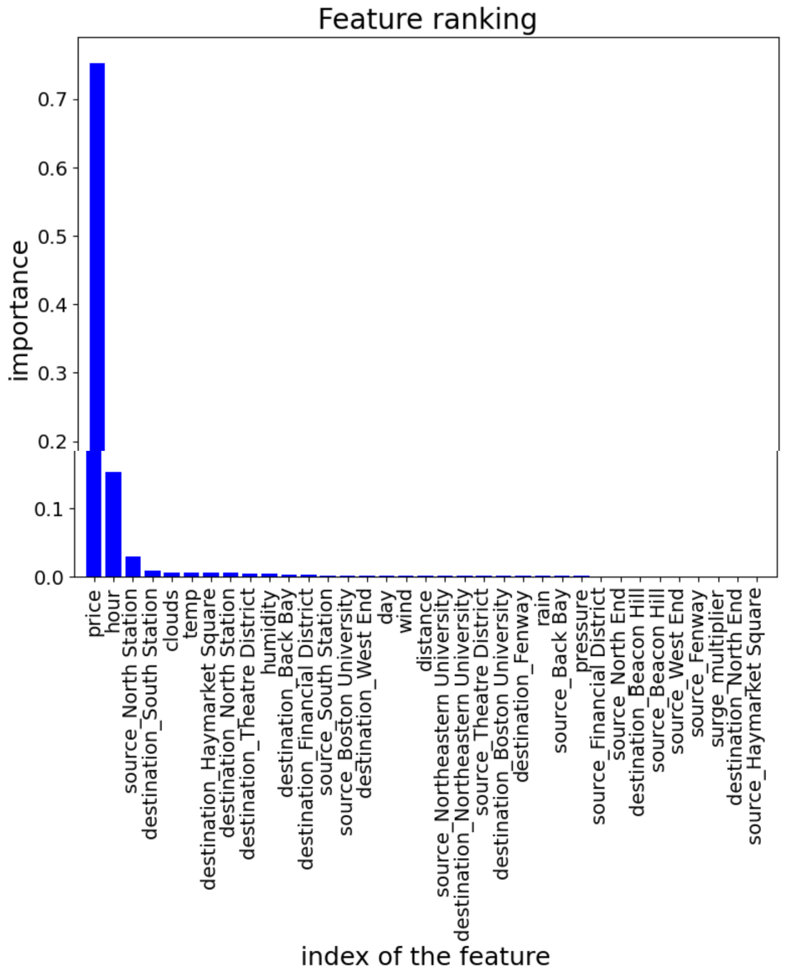
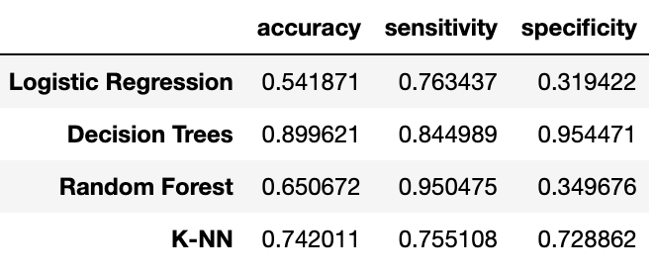
Fitting Models
Fig. 7
We fit four models over the course of the analysis; Logistic Regression, Decision Tree, Random Forest, and K-NN
We utilized the default parameters for each of our models given that we were already provided with a desirable AUC curve We assessed each of our models based on Accuracy, Sensitivity, Specificity metrics and ROC/AUC Curve
Based on the results of our assessment criteria, we identified the Decision Tree Model to be most appropriate when classifying “Lyft” rideshare services
Both our Random Forests Model and Decision Tree Model provided us with an AUC of 0.97
Given the Decision Tree Model provides us with better metrics for Accuracy, Sensitivity, and Specificity values, we went with the Decision Tree Model as our best model (see Fig. 8)
The top-3 most important features identified for the model are “age,” “hour,” and “source_North Station” (see Fig. 7)
Fig. 8

Slide 8
Managerial Implications/Insights
Based on the analysis we can say that the price of a ride is influenced by the distance of the ride and the surge multiplier applied, which are likely to be the main factors affecting the price
The time of the day does not seem to have a significant effect on the price or surge multiplier – this insight can be useful for ride-sharing companies to better understand the factors that drive ride pricing and to develop pricing strategies that optimize profits while remaining competitive.
We can see that from the data that the prices are not increasing when it rains – this could be due to consumers not wanting to travel when it rains heavily and being subjected to paying substantial costs
Based on the data we can see in terms of location, source and destination that the majority of locations which offered “Lyft” services are Back Bay, Boston University, Financial district,North , Theatre District – thus it would be appropriate to add additional locations
We also found the most important features for our Decision Tree Model – price, hour and the source North station played a key role in determining our insights, and should prioritized for consideration by employees when seeking “Lyft” as their rideshare service

Slide 9
Model Limitations
Limited Data: The data set has limited information on the Lyft Line service and the weather conditions, which could lead to inaccurate predictions
Data Quality: The data set had some missing values, and some data may have been inaccurate information, which altogether can, and did, affect the accuracy of the model
External Factors: External factors such as road closures, traffic congestion, and accidents can affect the accessibility of “Lyft” services, and these factors are not captured in the data set
Changing Market: The demand for Lyft Line may change over time due to changes in customer preferences, competition, or macroeconomic conditions
Missing Variables: The data set may not include all the relevant variables that affect the demand for Lyft Line, such as customer demographics, promotions, or events in the area.

Slide 10
Thank You, Drive Safe!

